Slide 1

Command-line Arguments

Slide 2
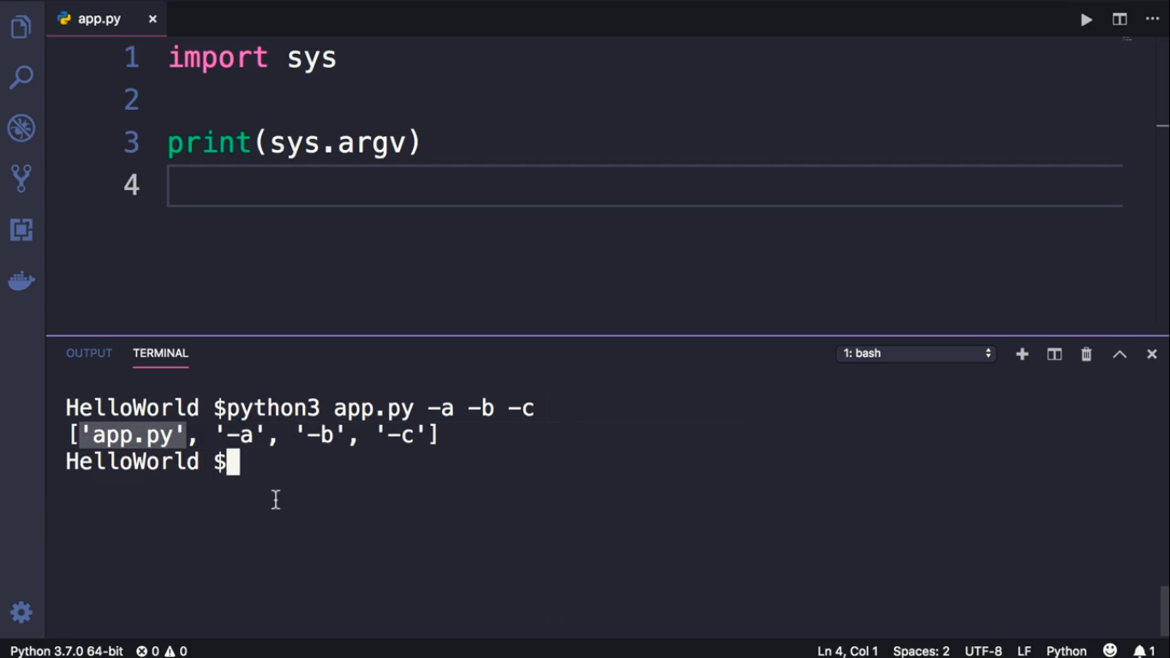

Slide 3
